Slide 1

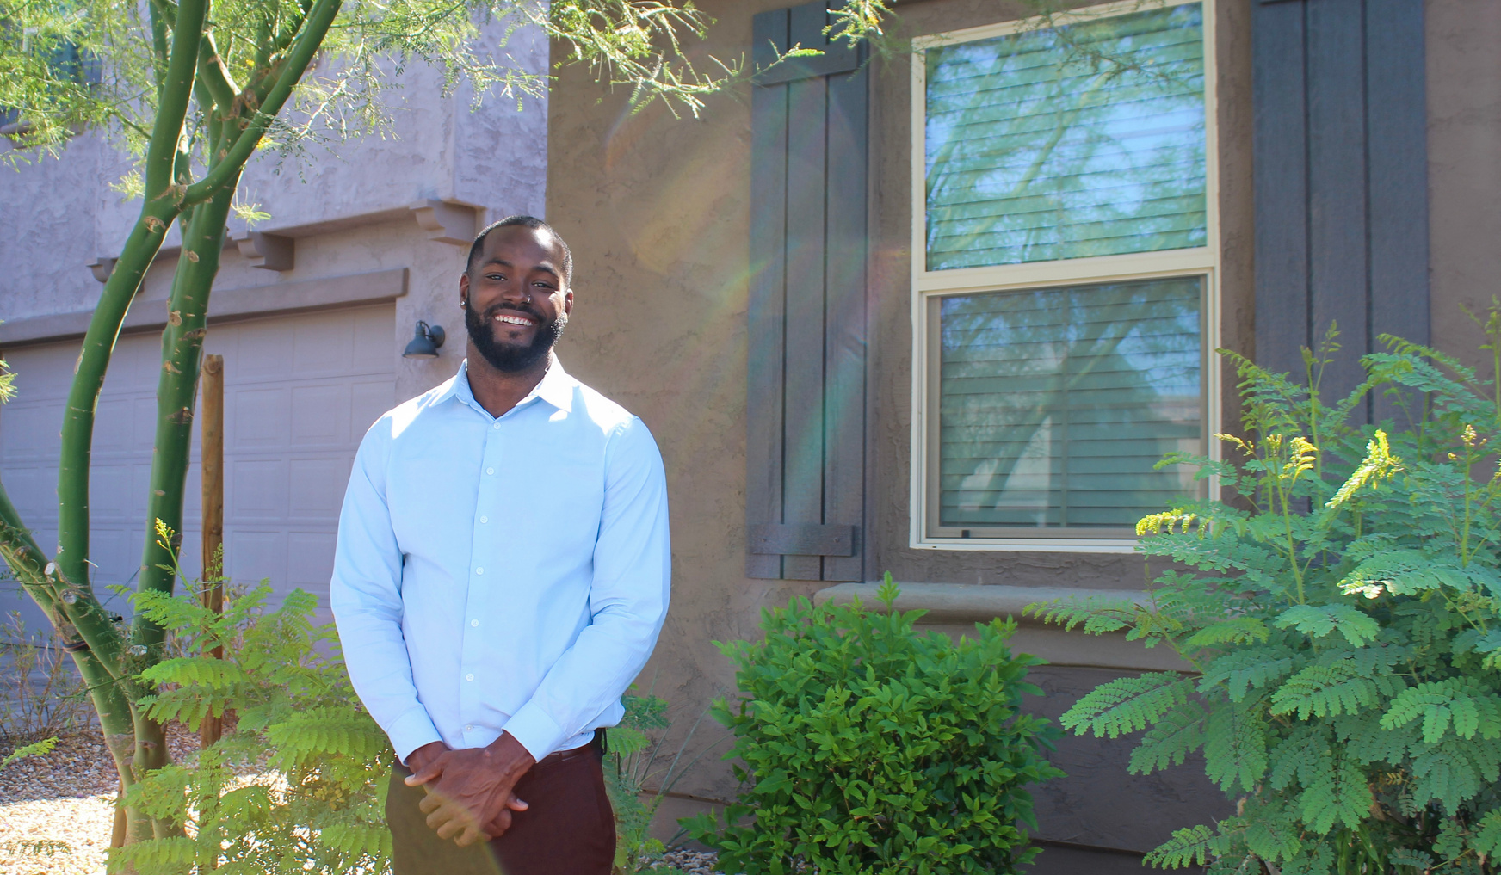
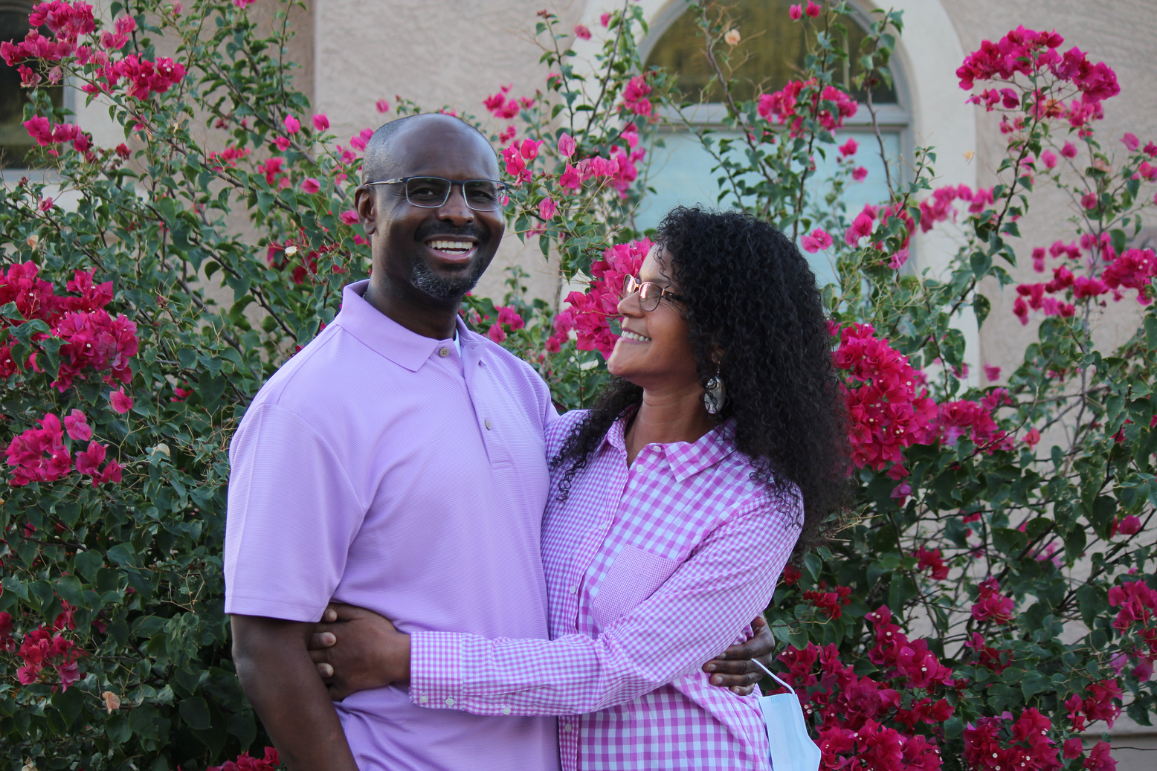
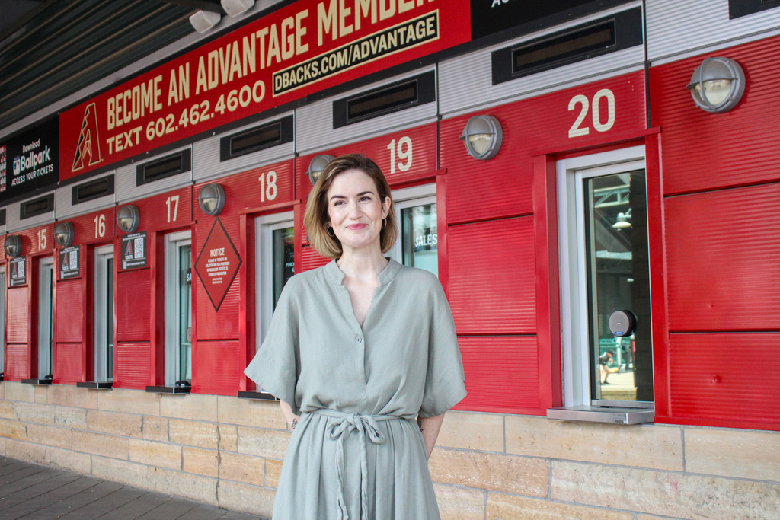
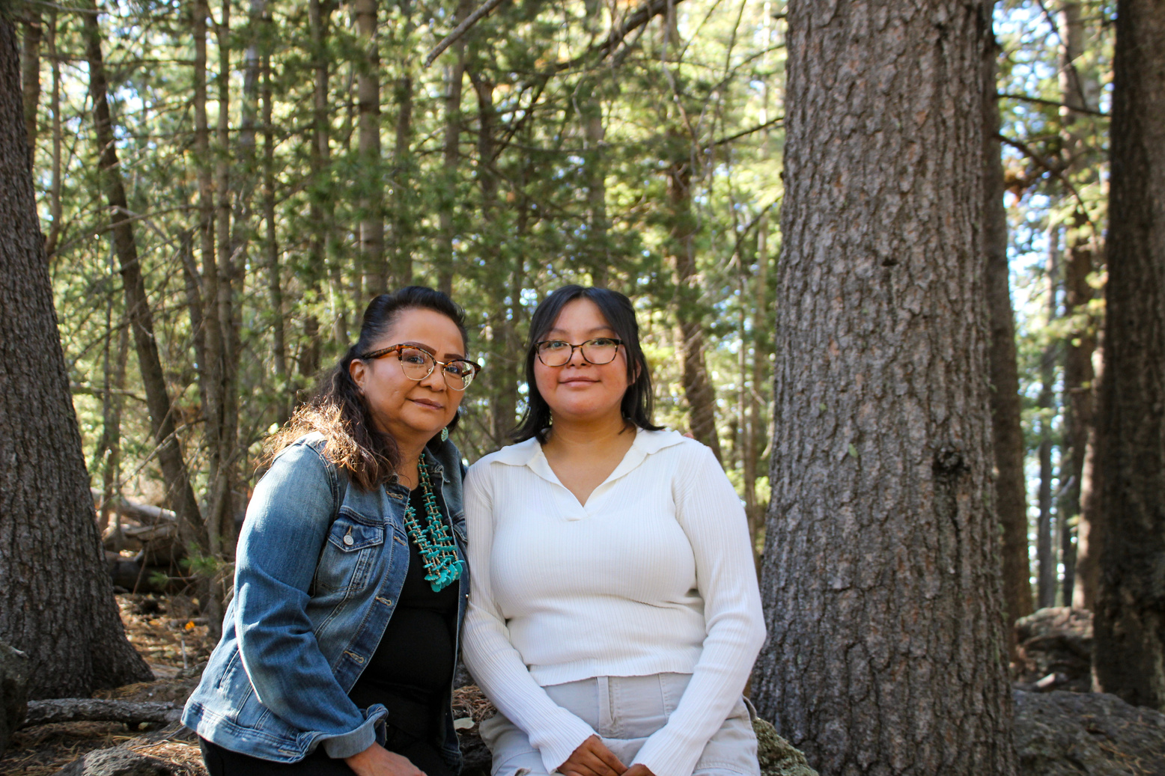

DONATION PROVIDES SECOND CHANCES LIKE THESE ...
Jazrome “AJ” Coulter,
kidney recipient
Claire Filson, heart recipient
Vangie Yazzie (l) & Makenna Jones, cornea recipient (r)
NATIONAL
MONTH

Slide 2
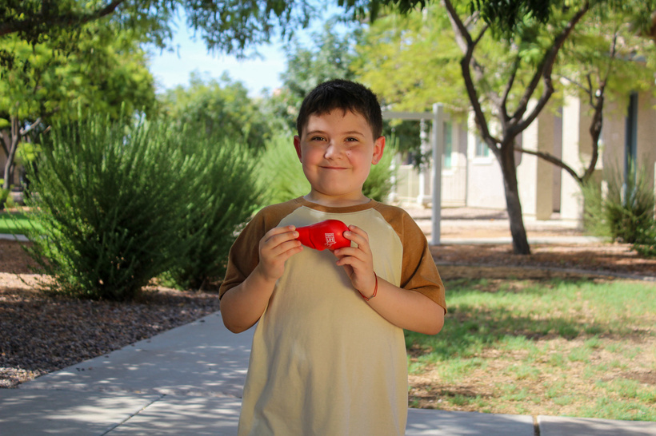
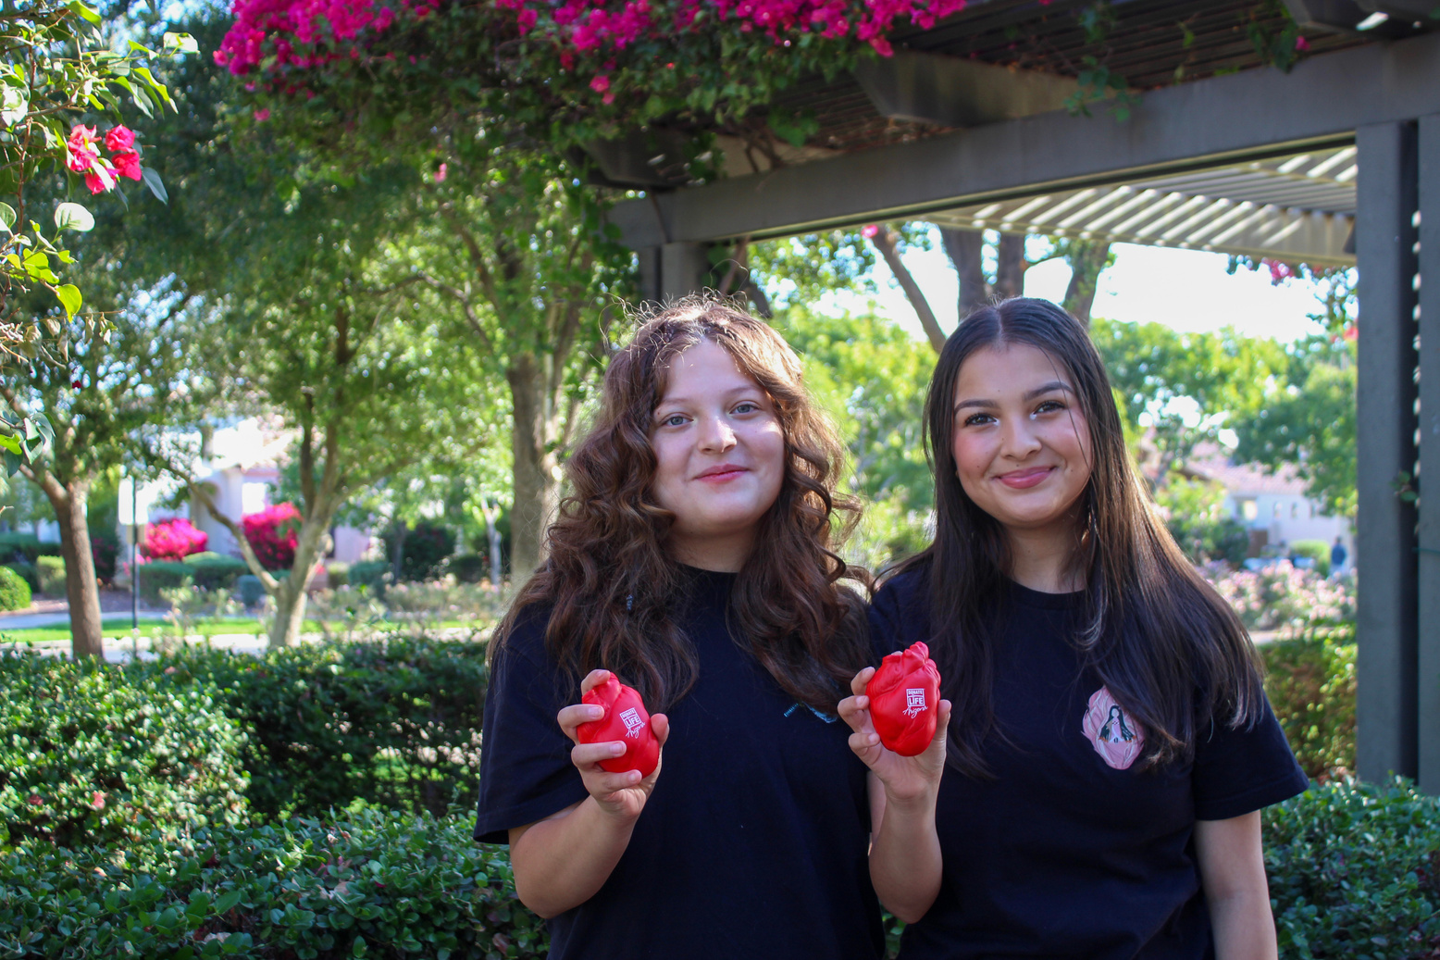
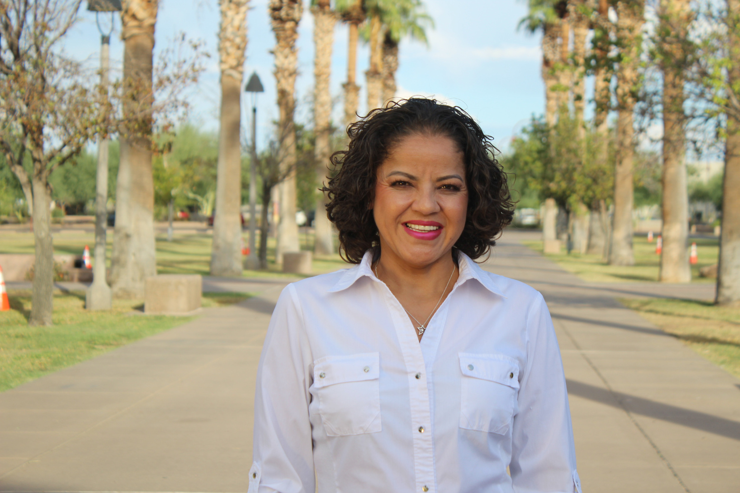
DONATION PROVIDES SECOND CHANCES LIKE THESE ...
Valen Krasnov, liver recipient
Adina (l) & Andrea Lopez (r),
heart recipients
Nancy Castillo, kidney recipient
NATIONAL
MONTH

Slide 3
NATIONAL
MONTH
DONATION PROVIDES
SECOND CHANCES LIKE THESE ...
“I SEE LIFE FROM A DIFFERENT PERSPECTIVE NOW AND HAVE BECOME MORE GRATEFUL FOR THE LITTLE MOMENTS IN LIFE.”
Nancy Castillo, kidney recipient

