Slide 1






legacy
LEAVE A
NATIONAL
MONTH

Slide 2
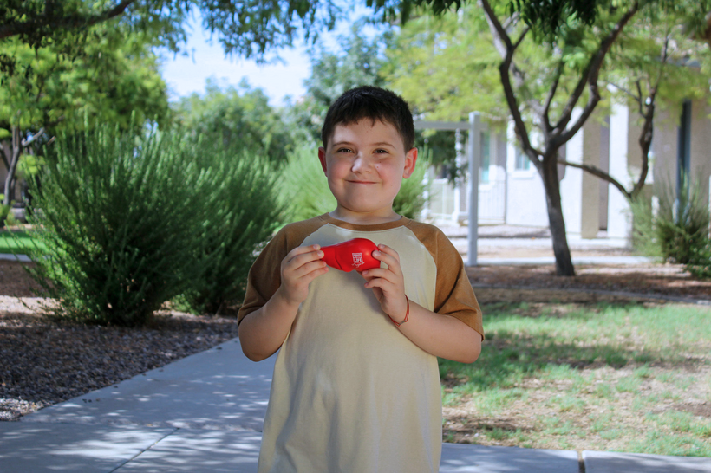
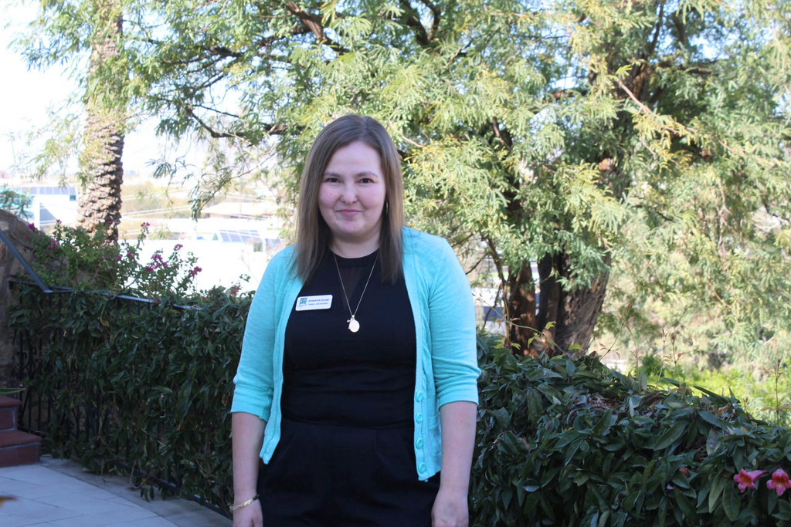
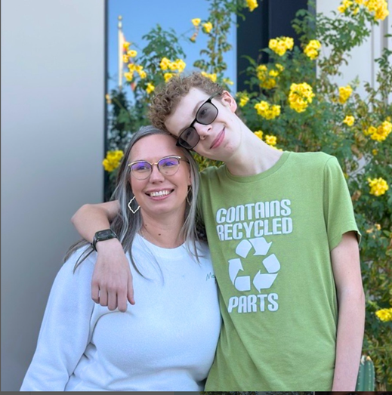

legacy
LEAVE A
Jennifer Adams,
Double-lung recipient
Valen Krasnov,
Liver recipient
Griffin Montejo,
Heart & liver recipient
NATIONAL
MONTH

Slide 3
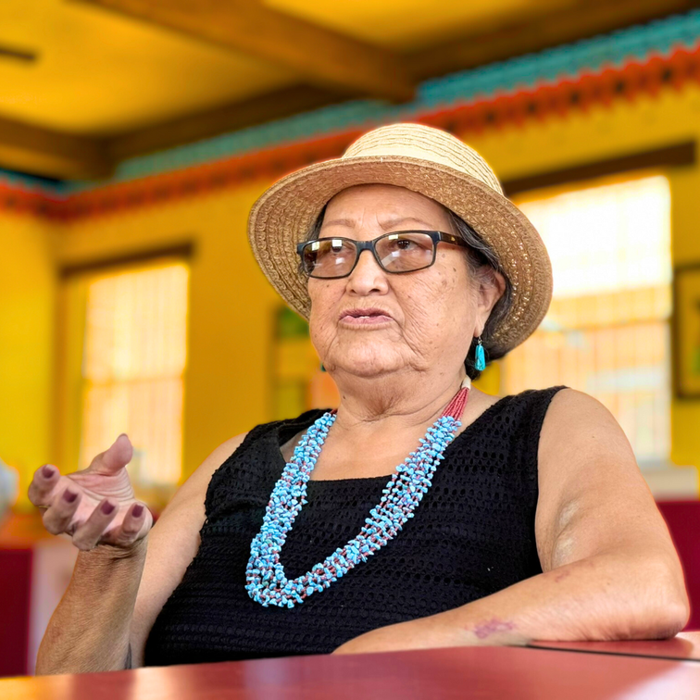
legacy
LEAVE A
“We don’t talk about death. It makes people uncomfortable.”
She lives where organ donation is never discussed, but Imogene Stevens, a rare dual kidney recipient of the San Carlos Apache Indian Reservation, is having difficult conversations.
Through these difficult conversations, we can build an inclusive transplant community – one that celebrates the diversity of all Arizonans and ensures equitable access to lifesaving treatments for everyone.
Imogene Stevens,
Dual kidney recipient
NATIONAL
MONTH

Slide 4
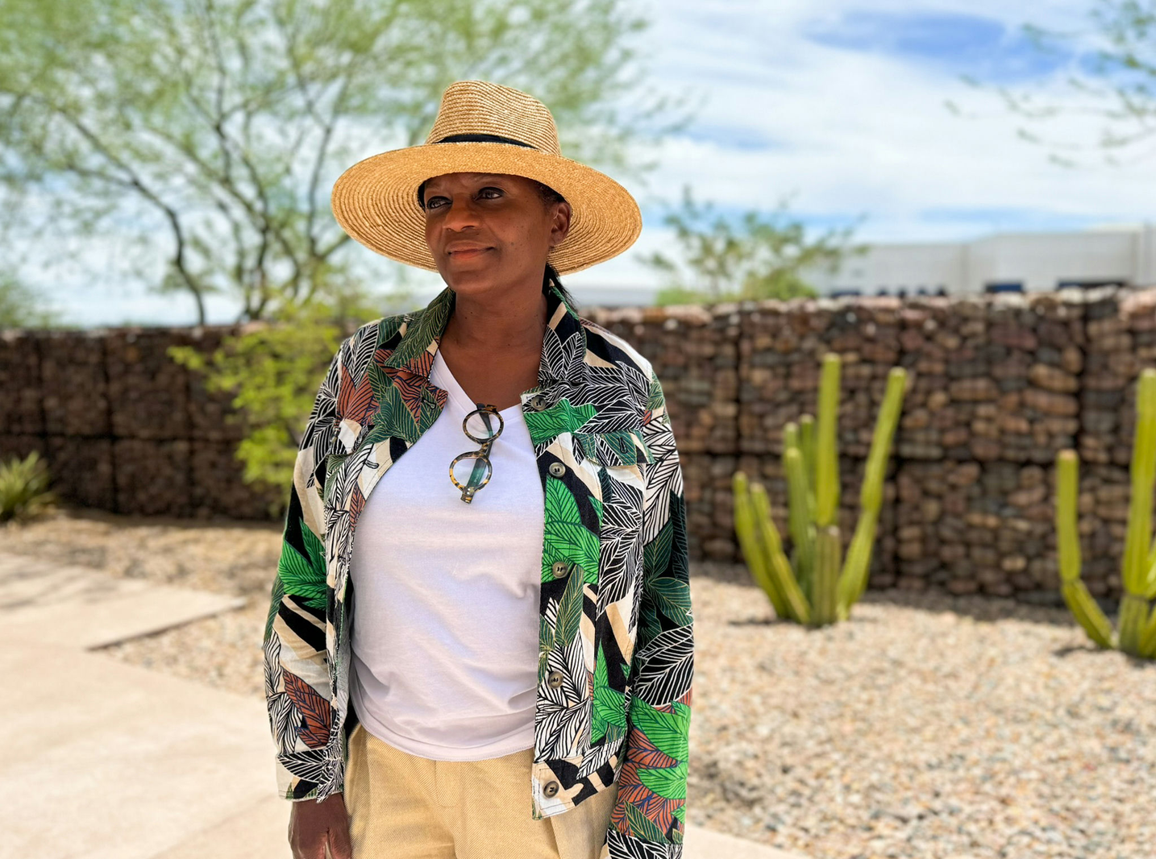
legacy
LEAVE A
“The gift of life makes me feel ‘chosen’ and purposed in this life to give in any and every way I can, to better someone else’s day, life, family and spirit.”
Kasaundra Johnson
Kidney and pancreas recipient
NATIONAL
MONTH

Slide 5
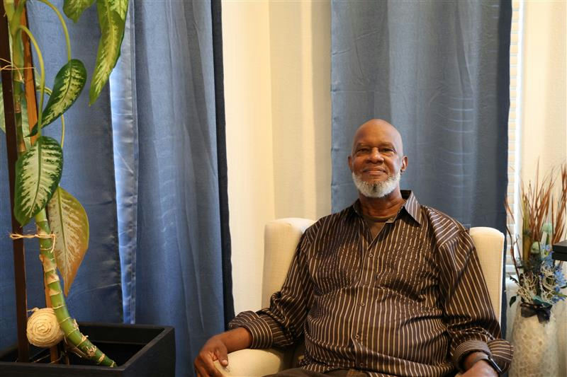
legacy
LEAVE A
In February 2024, Jeffrey received a second kidney transplant at Mayo Clinic, restoring the life he thought he had lost.
“I’m alive today because of a donor deciding to donate,” Jeffrey says.
Jeffery Powell
Kidney recipient
NATIONAL
MONTH

